Slide 1
UNO- MORSE CONVERSIE
BY:
- Kancharapu sai kiran
- Rathod Pavani
- Patti Akhilesh

Slide 2
PROBLEM STATEMENT: “ Conversion of Morse signal into Audio signal using Kmeans Clustering ”
Objectives :
Making job of Secret agents like RAW, CBI, SPYs easier
Conversion of secretly transmitted Morse signal into Audio signal within seconds
Transmission of secret signal with just one button
Any alphabet, any symbol, any number can be transmitted by just one button

Slide 3
Proposed Methodology Can be divided into 3 parts:
Taking input from user, converting into csv
Conversion of this csv into text using Machine Learning concept i.e., Kmeans clustering
Converting this text into Audio using gTTs library

Slide 4
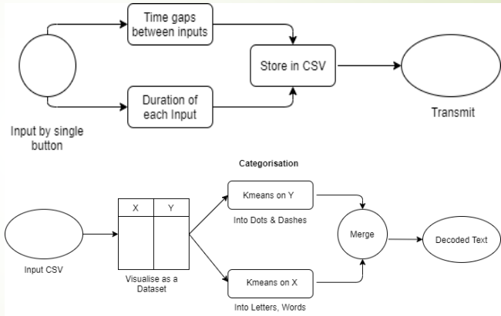
Architectural Diagrams
Input Mechanism:
Conversion mechanism:

Slide 5
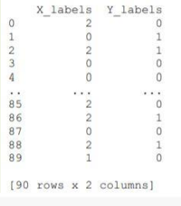

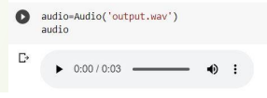

Results
Input is converted into csv, then categorised using ML in this way:
Categorised data is converted into text:
Text is converted into Audio:
Time of Execution:

